Slide 1

CMR COLLEGE OF ENGINEERING & TECHNOLOGY
Kandlakoya, Medchal, Hyderabad - 501401
Department of Computer Science and Engineering
Campus Selection System
Name of the student
21H55A0503-D.Shivanjali
21H55A0512-M.Nithesh
21H55A0517-P.Swetha
Under esteemed guidance of
Ms.B.Anuradha (Assistant Professor)

Slide 2
Outline
Abstract
Introduction
Literature survey
Existing system
- Problems in existing system
Research Objective of Presentation
Problem Definition
Research work
- Proposed system architecture
- Methods
- Comparison of Proposed system with an existing system
Performance Measure
Results
Conclusion
Future Work
References
Notes:
2

Slide 3
Abstract
Notes:
3

Slide 4
ABSTRACT
The main objective of placement tracking is to develop software which manages placement activities in college makes a interactive GUI where TPO can manage details of all students.
Although such a project has a very wide scope, this project contains the most important part i.e., displaying the personal and academic information of student and company.
The students and companies are also provided with the facility of editing some fields like username and password.

Slide 5
INTRODUCTION
Notes:
5

Slide 6
Introduction
Campus Selection System is a platform that provide interface between students and company.
System provide the list of suitable companies to the students according to academic qualification.
System provide the list of eligible students from a pool according to required skill for vacancy of company.
The system empowers a Database Administrator to input and maintain student and company data
Notes:
6

Slide 7
Literature Survey
Notes:
7

Slide 8
Literature Survey
The paper by Xiangpei Hu et al. (2001), introduces an SMS-based recommendation system. This system aims to facilitate more precise and cost-effective matching between companies and students.
It employs various methods, including semantic matching and SMS-based query matching, to assess the similarity between student and company profiles, thus enabling more accurate recommendations.
Yu Chun-Yang and Wang Hong (2008) focus on the design and implementation of an online virtual campus, leveraging advancements in web technology.
Notes:
8

Slide 9
Existing system
1.TRADITIONAL SYSTEM:
The main aim of this system is completing the campus selection in college under TPO and college management.
This traditional system uses more paper work and Time.
2.ONLINE SELECTION SYSTEM USING ASP.NET :
The aim of the project is to develop a online campus selection system which is updated version to conduct placements .
This website can be individual to its own college.
3. ONLINE PREDICTION SYSTEM :
This is also an online Campus selection system using HTML & CSS.
the online website in not Responsive and not secure.
Notes:
9

Slide 10
Problems in existing system
PROBLEMS IN EXISTING SYSTEM:
1. High Volume of Talent Pool
2. Resumes are the only way to select a candidate
3. Limited Staff & Time
4. Employer Branding to attract the younger generation
5. Outdated recruiting practices
Notes:
10

Slide 11
Research Objective
Notes:
11

Slide 12
Research objective
The project aims to achieve the following objectives:
Provide a centralized platform for managing placement activities
Streamline data management by automating tasks such as data entry, storage, and retrieval
Facilitate seamless communication between TPO, students, and companies
Ensure data integrity and security through robust database management
Improve the overall placement experience for students and companies.

Slide 13
Problem Definition
Notes:
13

Slide 14
Problem Definition
The problem definition outlines the specific issues faced in the existing placement process, such as:
Tedious manual handling of student and company data
Lack of centralized platform for managing placement activities
Ineffective communication between TPO, students, and companies
Difficulty in maintaining data integrity and security
Time-consuming processes for data entry and updates

Slide 15
Research Work
Notes:
15

Slide 16
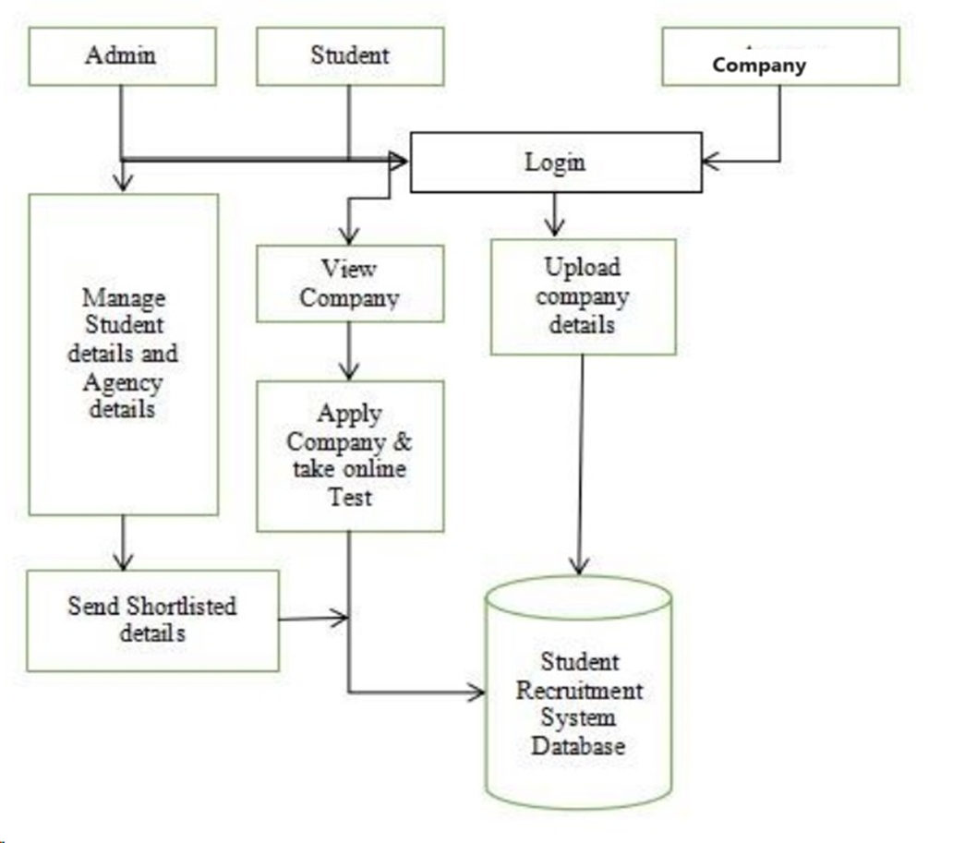
Proposed system architecture

Slide 17
Proposed Methods
ADMIN MODULE:
Admin will verify the students, accepting the job offer to students and the admin will add the company in the forum.
COMPANY MODULE:
Company can register with the college. Company can see how many students are eligible based on the criteria provided. Company can edit password if needed. Company will add the recruitment details.
STUDENT MODULE:
In the student module, the student should register then he can have login credentials. They can see the company criteria and other information provided by company. They can also check their status about the job.

Slide 18
Performance Measure:
Registration:
Student can register his details .
Company can register for required skilled student for specific job.
Apply for Job:
After login in system, student can apply for job according to his/her skill and take the test.
Post Job:
Company can post for a job and send mail to admin for required vacancy of employee.
Exam :
Company take a various types of exam to select a eligible students,

Slide 19
Result Analysis
Computer based information system are designed to improve existing system. It has user friendly interface having quick authenticated access to documents.
It provides the facility of maintaining the details of the students. It will reduce the paper work and utilize the maximum capabilities of the Setup and organization
It will save time and money which are spending in making reports and collecting data. It can be accessed throughout the organization with proper login provided

Slide 20
Conclusion
Campus Selection System is a platform that provides an interface between students and company.
System provides the list of suitable companies to the students, according to their educational qualification, experience and their preferences. The project has a very vast scope in the future.
Project can be updated in near future as and when requirement for the same arises, as it is very flexible in terms of expansion.

Slide 21
Future work
In coming time, we could have the Short Message Service facility for the workers and employee search engine which could provide the result on the basis of different procedure to search.
Students can also give feedback about the company and the company can view the feedback given by the students.

Slide 22
References
www.eci.gov.in
www.goggle.com
www.tutorialpoints.com/java/
www.askjeeves.com
www.apeci.com
www.w3schools.com
www.Wikipedia.com
www.jdbc-tutuorials.com
www.JSP.net
www.xamppserver.com
www.apache.org
www.tutorialpoints.com/mysql

Slide 23
Thank You!

